Slide 1
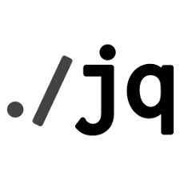

Constructing a null, number, string and boolean JSON Data
NarendraP
Jq Command for Bash Shell Scripting

Slide 2
Constructing null, number, string and boolean data's
Syntax:
jq -n ‘’ --> null
jq ‘null’ inputFile --> null
jq -n ’4’ --> number
jq -n ‘”jq”’ --> string
jq ‘filter/function’ inputFile --> string
jq -n ‘true/false’ --> boolean
Jq is a command-line utility to parse JSON Data

Slide 3
Thank you

